Slide 1
Day 1
Course INTRODUCTION & lecture 1 on PROJECT PLANNING process

Slide 2
Course Details
MSPM (2nd Semester) Bahria University
Course: Project Planning, Scheduling and
Time Management (PPS&TM)
Session: Spring 2016
Day: Sundays
Timing: 1000-1300
Credit Hours: 3 hours /class (per week)
Pre-Requisites: Project Management Fundamentals

Slide 3
Course
DESCRIPTION
The course will enable participants to understand project planning in general and project scheduling in particular, explaining time management concepts as per standard defined by Project Management Institute (PMI) through PMBoK 5th edition
This course will also enable participants to gain practical exposure about reporting requirements and presentation skills through class discussion and project work.

Slide 4
LEARNING OBJECTIVES
Introduce the concept of project planning, scheduling, and planning process interactions in regard with latest research and developed standards.
Provide participants with training to understand the project time management processes, tools and various techniques with clearly defined outputs and responsibilities.
The course also provides in-depth understanding of Project Scheduling Model Principles, Concepts, Management, Creation, Maintenance, Analysis and Components.
The course also highlights how project managers can use earned value to calculate earned schedule. (More detail in Third Semester)

Slide 5
METHODOLOGY
Class lectures
One session dedicated for a Assignment Discussion
Practical examples and selected case studies will be shared to facilitate better learning
Class presentations will be shared
Time to time different key articles / documents will be shared in soft copies
University attendance policy will apply, however, it is highly recommended that all classes are attended by all students
Students with educational and/or physical challenges are entitled to extra attention and time from the instructor. Therefore students are advised to notify the course instructor at the beginning of the course

Slide 6
CLASS CONDUCT
Turn mobile phones on silent
Avoid text / receiving calls during class
Avoid cross talking / arguments during any question / answer
Raise hand before asking anything / contributing anything
Observe class timings (attendance 10 Minutes after start time) 10 Min Rule.
No food / drinks allowed (except water)

Slide 7
COURSE CONTENT
Week | Topic | Contact Hours | Activity | Assignment
1 | Course Introduction, Review and Project Planning Processes | 3 | Lecture/Discussion
2 | Project Processes Interaction | 3 | Lecture/Discussion
3 | Project Time Management | 3 | Lecture/Discussion | Course Project Plan discussion(2nd Session)
4 | Schedule Management planning and defining processes | 3 | Lecture/Discussion | Assignment One/Quiz 1
5 | Sequence Activities/ Tools and techniques | 3 | Lecture/Discussion
6 | CPM | 3 | Lecture/Discussion
7 | Estimate Resources and Durations | 3 | Lecture/Discussion | Quiz 2
8 | Schedule Development /Review for mid term | 2+1 | Lecture/Discussion
9 | Schedule Model Management | 3 | Lecture/Discussion | Quiz 3
10 | Schedule Model Creation | 3 | Lecture/Discussion
11 | Schedule Model Maintenance |  | Lecture/Discussion | Quiz 4
12 | Project presentation | 3 | Lecture/Discussion
13 | Control Schedule | 3 | Lecture/Discussion
14 | Earned Schedule/ Revision | 3 | Lecture/Discussion
16 | Final Exam | 3 | Final exam/Review

Slide 8
MARKS DISTRIBUTION
Marks Head | Total Frequency | Marks /Frequency | Total Marks /Head | Remarks
Mid-term | 1 | 30 | 30
Final Paper | 1 | 40 | 40
Class Behavior, Quizes and Assignments | Throughout |  | 30
 |  | Total Marks | 100

Slide 9
Reference BOOKS
Project Management Body Of Knowledge (PMBoK) Guide, Project Management Institute (PMI), 5th Edition, Project Management Institute (PMI), 2013
Project Management Institute Practice Standard of Scheduling, Second Edition, 2011.

Slide 10
Course
ACADEMIC INTEGRITY
This course seeks to empower students for independent learning, resourcefulness, clear thinking, and perception.
All submitted work and activities should be genuine reflections of individual achievement from which the student should derive personal satisfaction and a sense of accomplishment.
Plagiarism and cheating subvert these goals and will be treated according to the policy stated in the Student Handbook.
The instructor reserves the right to utilize electronic means to help prevent plagiarism.

Slide 11
Lecture 1
Processes Review/PROJECT PLANNING

Slide 12
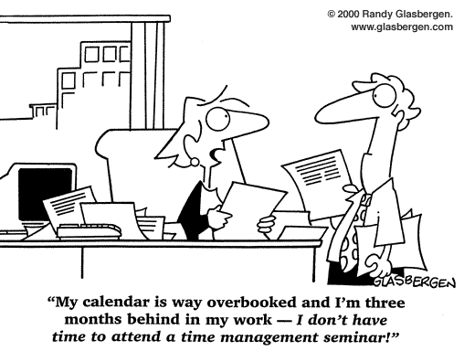
Time Management

Slide 13
Project management
Project Management is the application of knowledge, skills, tools, and techniques to project activities to meet project requirements.
This application of knowledge requires the effective management of appropriate processes.
Notes:
Chapter 3
PROJECT MANAGEMENT PROCESSES
PROJECT MANAGEMENT
Project Management is the application of knowledge, skills, tools, and techniques to project activities to meet project requirements.
This application of knowledge requires the effective management of appropriate processes.

Slide 14
ProCESS
A Process is a set of interrelated actions and activities performed to achieve a pre-specified product, result, or service.
Each process is characterized by
its inputs,
the tools and techniques, and
resulting outputs.
Notes:
Chapter 3
PROJECT MANAGEMENT PROCESSES
PROCESS
A Process is a set of interrelated actions and activities performed to achieve a pre-specified product, result, or service.
Each process is characterized by
its inputs,
the tools and techniques, and
resulting outputs.

Slide 15
OPAs and EEFs
Project Manager must consider Organizational Process Assets and Enterprise Environmental Factors.
These must be taken into account for every process, even if they are not explicitly listed as inputs in the process specification.
Organizational Process Assets (OPAs) provide guidelines and criteria for tailoring the organization’s processes to the specific needs of the project.
Enterprise Environmental Factors (EEFs) may constrain the project management options.
Notes:
Chapter 3
PROJECT MANAGEMENT PROCESSES
ORGANIZATIONAL PROCESS ASSETS AND ENTERPRISE ENVIRONMENTAL FACTORS
Project Manager must consider Organizational Process Assets and Enterprise Environmental Factors.
These must be taken into account for every process, even if they are not explicitly listed as inputs in the process specification.
Organizational Process Assets (OPAs) provide guidelines and criteria for tailoring the organization’s processes to the specific needs of the project.
Enterprise Environmental Factors (EEFs) may constrain the project management options.

Slide 16
Project team must:
Select appropriate processes required to meet the project objectives
Use a defined approach that can be adopted to meet requirements
Establish and maintain appropriate communication and engagement with stakeholders
Comply with requirements to meet stakeholder needs and expectations
Balance the competing demands of scope, time, cost, quality, resources, and risk to produce the specified product, service, or result.
Notes:
Chapter 3
PROJECT MANAGEMENT PROCESSES
PROJECT TEAMS MUST:
Select appropriate processes required to meet the project objectives
Use a defined approach that can be adopted to meet requirements
Establish and maintain appropriate communication and engagement with stakeholders
Comply with requirements to meet stakeholder needs and expectations
Balance the competing demands of scope, time, cost, quality, resources, and risk to produce the specified product, service, or result.

Slide 17
Project Processes
Project Management Processes
Ensures the effective flow of the project throughout its life cycle.
Encompass the tools and techniques involved in applying the skills and capabilities described in the Knowledge Areas.
Product-oriented Processes
Specify and create the project’s product.
Typically defined by the project life cycle and vary by application area as well as the phase of product life cycle.
The scope of the project cannot be defined without basic understanding of how to create the specified product.
Notes:
Chapter 3
PROJECT MANAGEMENT PROCESSES
PROJECT PROCESSES
Project Management Processes
Ensures the effective flow of the project throughout its life cycle.
Encompass the tools and techniques involved in applying the skills and capabilities described in the Knowledge Areas.
Product-oriented Processes
Specify and create the project’s product.
Typically defined by the project life cycle and vary by application area as well as the phase of product life cycle.
The scope of the project cannot be defined without basic understanding of how to create the specified product.
For Example, various construction techniques and tools need to be considered when determining the overall complexity of the house to be built.

Slide 18
GOOD PRACTICE
Project management processes apply globally and across industry groups.
Good Practice means there is a general agreement that the application of project management processes has been shown to enhance the chances of success over a wide range of projects.
Notes:
Chapter 3
PROJECT MANAGEMENT PROCESSES
GOOD PRACTICE
Project management processes apply globally and across industry groups.
Good Practice means there is a general agreement that the application of project management processes has been shown to enhance the chances of success over a wide range of projects.

Slide 19
RESPONSIBILITY
This does not mean that the knowledge, skills, and processes described should always be applied uniformly on all projects.
For any given project, the project manager, in collaboration with the project team, is always responsible for determining which processes are appropriate, and the appropriate degree of rigor for each process.
Notes:
Chapter 3
PROJECT MANAGEMENT PROCESSES
RESPONSIBILITY
This does not mean that the knowledge, skills, and processes described should always be applied uniformly on all projects.
For any given project, the project manager, in collaboration with the project team, is always responsible for determining which processes are appropriate, and the appropriate degree of rigor for each process.

Slide 20
PROJECTS IN ORGANIZATIONS
Project exists within an organization and do not operate as a closed system.
They require input data from the organization and beyond, and deliver capabilities back to the organization.
The project processes may generate information to improve the management of
future projects and
organizational process assets.
Notes:
Chapter 3
PROJECT MANAGEMENT PROCESSES
PROJECTS IN ORGANIZATIONS
Project exists within an organization and do not operate as a closed system.
They require input data from the organization and beyond, and deliver capabilities back to the organization.
The project processes may generate information to improve the management of
future projects and
organizational process assets.

Slide 21
NATURE OF PM PROCESSES
PMBOK® Guide describes the nature of project management processes in terms of the
integration between the processes,
their interactions, and
the purposes they serve.
Project management processes are grouped into five categories known as Project Management Process Groups.
Notes:
Chapter 3
PROJECT MANAGEMENT PROCESSES
NATURE OF PM PROCESSES
PMBOK® Guide describes the nature of project management processes in terms of the
integration between the processes,
their interactions, and
the purposes they serve.
Project management processes are grouped into five categories known as Project Management Process Groups.

Slide 22
FIVE PROCESS GROUPS
Initiating Process Groups. Performed to define a new project or a phase of an existing project by obtaining authorization to start the project or phase.
Planning Process Group. Processes required to establish the scope of project, refine the objectives, and define the course of action required to attain the objectives that the project was undertaken to achieve.
Executing Process Group. Performed to complete the work defined in the project management plan to satisfy the project specifications.
Monitoring and Controlling Process Group. Required to track, review, and regulate the progress and performance of the project; identify any areas in which changes to the plan are required; and initiate the corresponding changes.
Closing Process Group. Performed to finalize all activities across all Process Groups to formally close the project or phase.
Notes:
Chapter 3
PROJECT MANAGEMENT PROCESSES
FIVE PROCESS GROUPS
Initiating Process Groups. Performed to define a new project or a phase of an existing project by obtaining authorization to start the project or phase.
Planning Process Group. Processes required to establish the scope of project, refine the objectives, and define the course of action required to attain the objectives that the project was undertaken to achieve.
Executing Process Group. Performed to complete the work defined in the project management plan to satisfy the project specifications.
Monitoring and Controlling Process Group. Required to track, review, and regulate the progress and performance of the project; identify any areas in which changes to the plan are required; and initiate the corresponding changes.
Closing Process Group. Performed to finalize all activities across all Process Groups to formally close the project or phase.

Slide 28
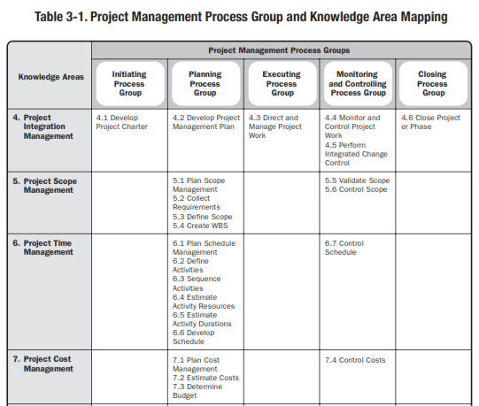

Slide 29
PLANNING
Project Planning is part of project management, which relates to the use of schedules such as Gantt charts to plan and subsequently report progress within the project environment
Project Planning is often used to organize different areas of a project, including project plans, work loads and the management of teams and individuals
Project Planning is systematic sequencing and scheduling of the tasks comprising a project. Also called work planning.
Notes:
Chapter 5
PROJECT SCOPE MANAGEMENT
Project Scope Management includes the processes required to ensure that the project includes all the work required, and only the work required, to complete the project successfully.
Managing the project scope is primarily concerned with defining and controlling what is and is not included in the project.

Slide 30
PLANNING
PROJECT PLANNING
Project Planning is a discipline for stating how to complete a project within a certain timeframe, usually with defined stages, and with designated resources.
One view of project planning divides the activity into:
Setting objectives (these should be measurable)
Identifying deliverables
Planning the schedule
Making supporting plans
http://searchcrm.techtarget.com/definition/project-planning retrieved Sep 01, 2013.
Notes:
Chapter 5
PROJECT SCOPE MANAGEMENT
Project Scope Management includes the processes required to ensure that the project includes all the work required, and only the work required, to complete the project successfully.
Managing the project scope is primarily concerned with defining and controlling what is and is not included in the project.

Slide 31
PLANNING
PLANNING PROCESS GROUP
Planning Process Group consists of those processes performed to
establish the total scope of the effort,
define and refine the objectives, and
develop the course of action required to attain those objectives.
The planning processes develop the project management plan and the project documents that will be used to carry out the project.
The complex nature of project management may require the use of repeated feedback loops for additional analysis.
Notes:
Chapter 5
PROJECT SCOPE MANAGEMENT
Project Scope Management includes the processes required to ensure that the project includes all the work required, and only the work required, to complete the project successfully.
Managing the project scope is primarily concerned with defining and controlling what is and is not included in the project.

Slide 32
PLANNING
PLANNING PROCESS GROUP
As more project information or characteristics are gathered and understood, additional planning will likely be required.
Significant changes occurring throughout the project life cycle trigger a need to revisit one or more of the planning processes and possibly some of the initiating processes.
This progressive detailing of the project management plan is called progressive elaboration, indicating that planning and documentation are iterative and ongoing activities.
Notes:
Chapter 5
PROJECT SCOPE MANAGEMENT
Project Scope Management includes the processes required to ensure that the project includes all the work required, and only the work required, to complete the project successfully.
Managing the project scope is primarily concerned with defining and controlling what is and is not included in the project.

Slide 33
PLANNING
PLANNING PROCESS GROUP
The key benefit of this Process group is to delineate the strategy and tactics as well as the course of action or path to successfully complete the project or phase.
When the Planning Process Group is well managed, it is much easier to get stakeholder buy-in and engagement.
These processes express how this will be done, setting the route to the desired objective.
The project management plan and project documents developed as outputs from the Planning Process Group will explore all aspects of the scope, time, cost, quality, communications, human resources, risks, procurements, and stakeholder engagement.
Notes:
Chapter 5
PROJECT SCOPE MANAGEMENT
Project Scope Management includes the processes required to ensure that the project includes all the work required, and only the work required, to complete the project successfully.
Managing the project scope is primarily concerned with defining and controlling what is and is not included in the project.

Slide 34
PLANNING
PLANNING PROCESS GROUP
Updates arising from approved changes during the project may significantly impact parts of the project management plan and the project documents.
generally during Monitoring and Controlling processes and
specifically the Direct and Manage Project Work Process
Updates to these documents provide greater precision with respect to schedule, costs, and resource requirements to meet the defined project scope.
Notes:
Chapter 5
PROJECT SCOPE MANAGEMENT
Project Scope Management includes the processes required to ensure that the project includes all the work required, and only the work required, to complete the project successfully.
Managing the project scope is primarily concerned with defining and controlling what is and is not included in the project.

Slide 35
PLANNING
PLANNING PROCESS GROUP
The project team seeks input and encourages involvement from all stakeholders when planning the project and developing the project management plan and project documents.
While the act of collecting feedback and refining the documents cannot continue indefinitely, procedures set by the organization dictate when the initial planning ends.
These procedures will be affected by
the nature of the project,
the established project boundaries,
appropriate monitoring and controlling activities,
the environment in which the project will be performed.
Notes:
Chapter 5
PROJECT SCOPE MANAGEMENT
Project Scope Management includes the processes required to ensure that the project includes all the work required, and only the work required, to complete the project successfully.
Managing the project scope is primarily concerned with defining and controlling what is and is not included in the project.

Slide 36
THE OUTPUT
PROJECT MANAGEMENT PLAN
Project Baselines
Scope baseline
Schedule baseline
Cost baseline
Subsidiary Plan
Scope Management Plan
Requirements Management Plan
Schedule Management Plan
Cost Management Plan
Quality Management Plan
Process Improvement Plan
Human Resource Plan
Communications Management Plan
Risk Management Plan
Procurement Management Plan
Stakeholder Management Plan

Slide 37
THE OUTPUT
PROJECT MANAGEMENT PLAN
May also include:
Life cycle selected for each phase
Details of the tailoring decisions by project team
Project management processes selected
Level of implementation for each selected process
Descriptions of the tools and techniques to be used
Description of how the selected process will be used
Descriptions of how work will be executed to accomplish project objectives
Change management plan that documents how changes will be monitored and controlled
Configuration management plan
Description of how the integrity of project baselines will be maintained
Requirements and techniques for communication amongst stakeholders
Key management reviews for content, extent, and timing to open address issues/pending decisions.

Slide 38
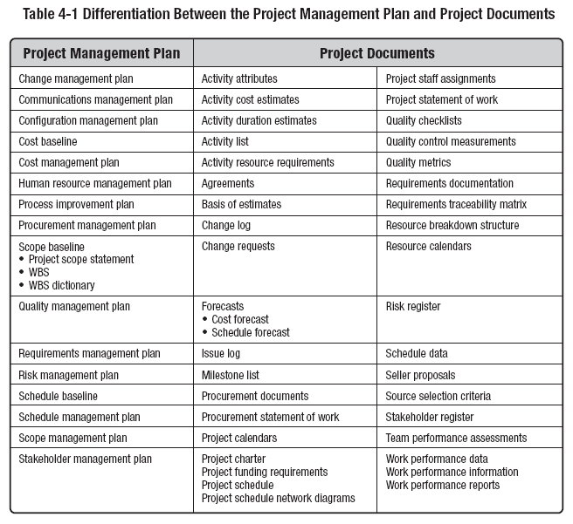
THE DIFFERENCE

Slide 39
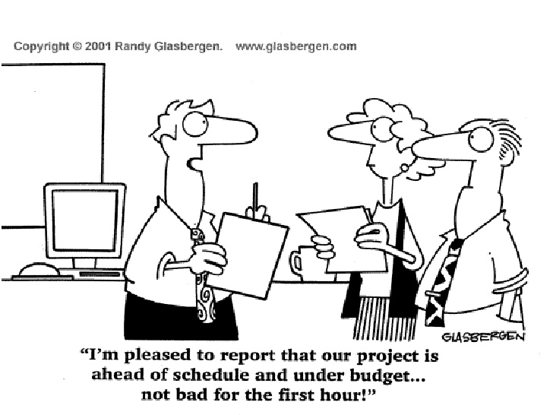
LECTURE One is Over

